Slide 1
Application
Peace of code that is written for specific purpose

Slide 2
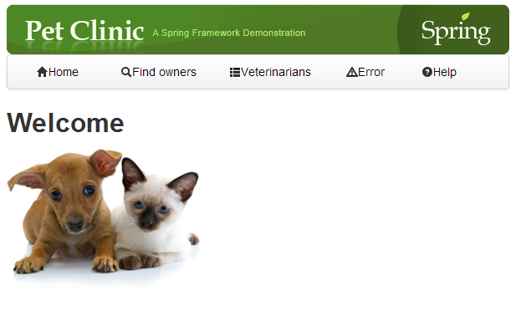
Spring pet clinic
Application that is designed for taking care of pets and plants.

Slide 3
E-learning portal
An eLearning portal is a website that offers learners interaction and collaboration on eLearning content like courses, presentations, podcasts and tests as well as content management for eLearning providers.

Slide 4
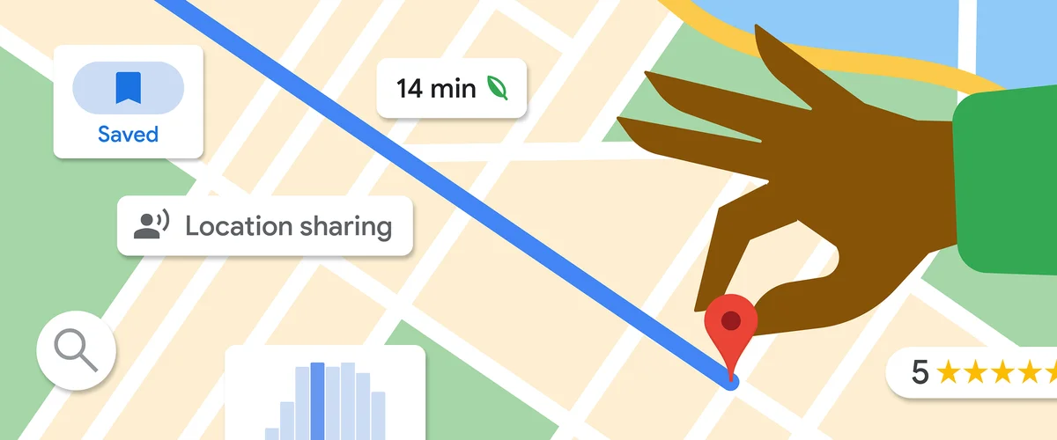
Google Map
It’s designed to find the route between source and destination.

Slide 5


Slide 6
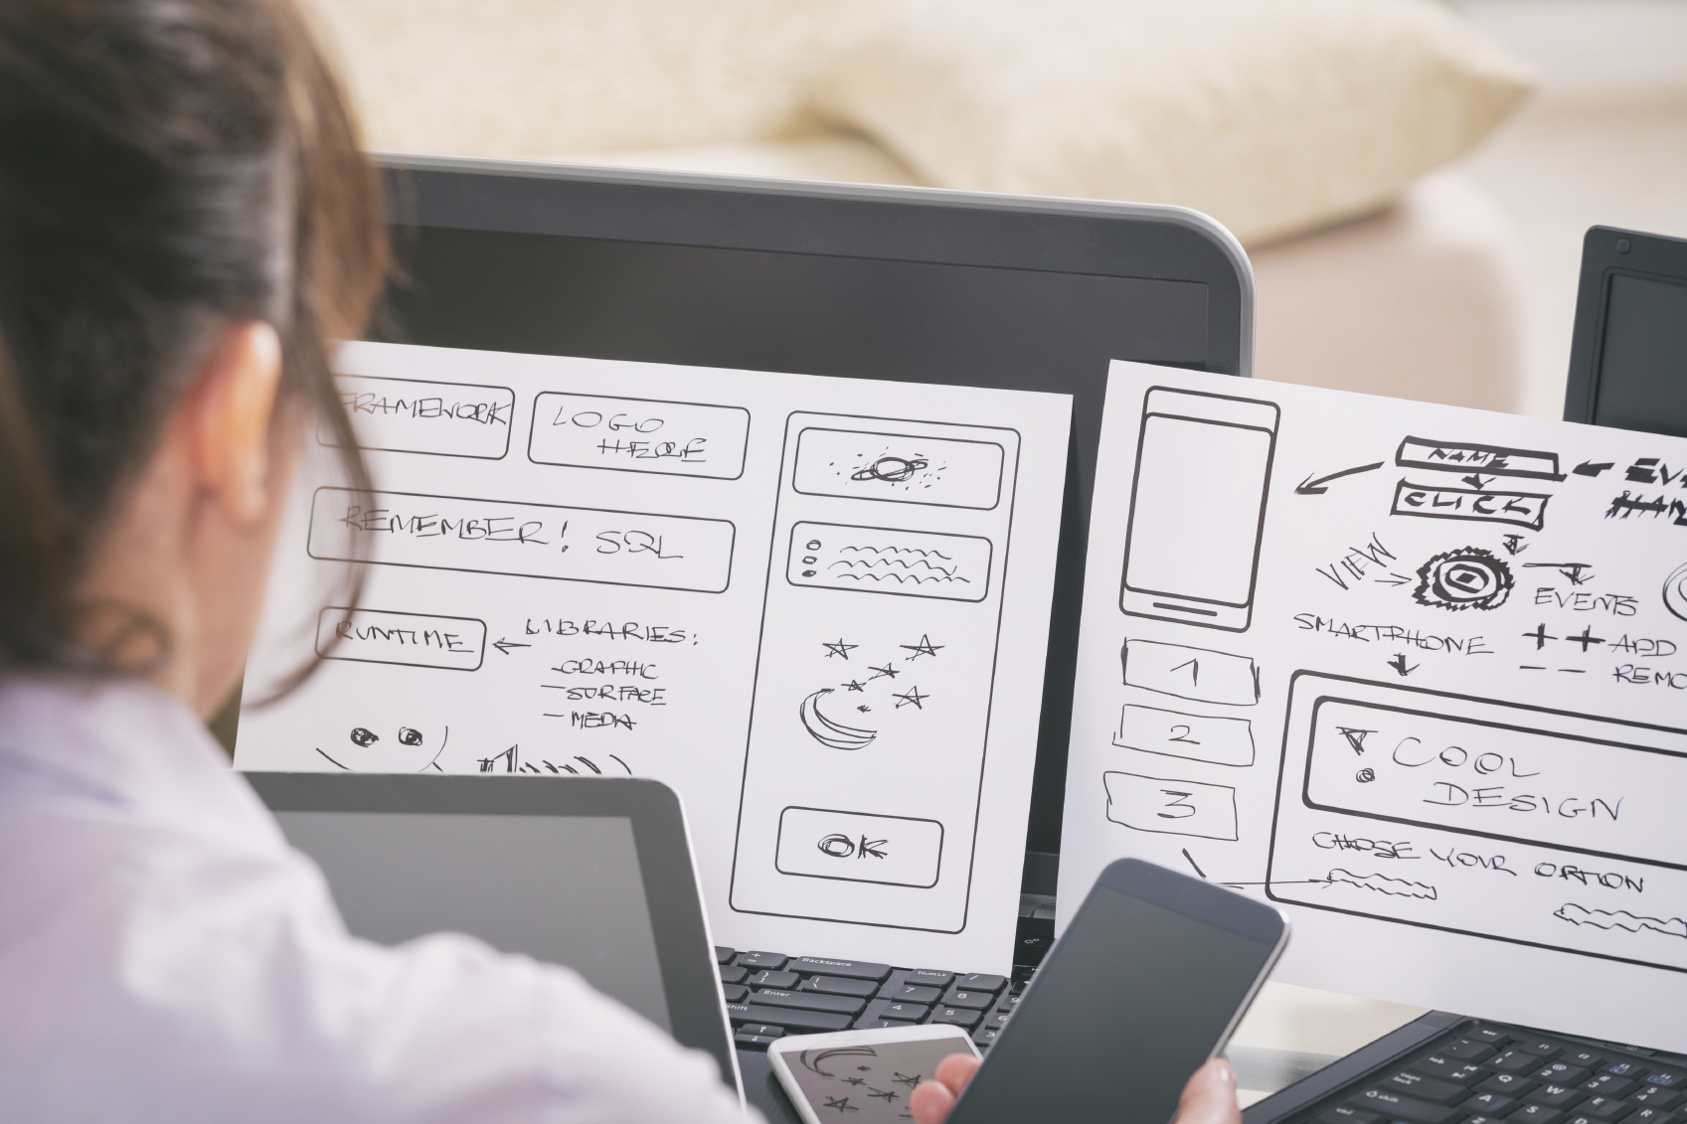
Application Designed or Solution architect

Slide 7
Role of Application Designer
Application designer know what is application all about, and he designed solution for it.

Slide 8
Application Logic
Every Application has 3 logic
Business logic
Presentation logic
Database/storage logic

Slide 9
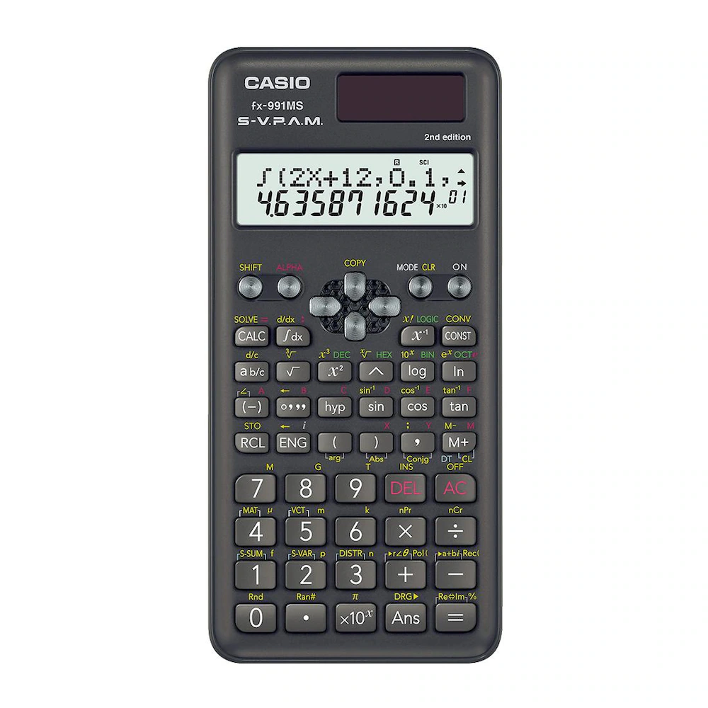
Example: Calculator

Slide 10
Understaing programming things
{
Int a,b,c;
c= a+ b; //storage logic
}
What is Application Need> CPU, Memory, but how I can say?

Slide 11
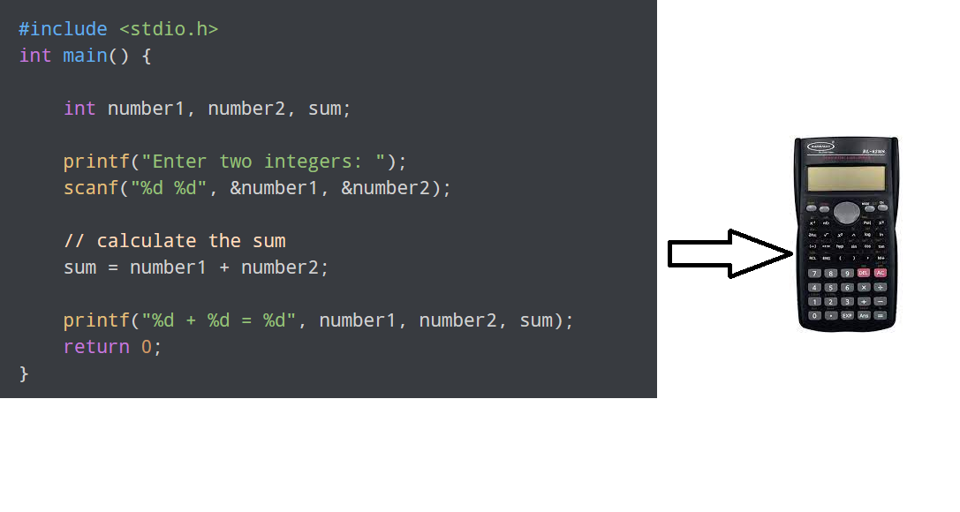
Question: How my program is printing in GUI

Slide 12
Software
A set of instructions that directs a computer’s hardware to perform a task is called a program, or software program.

Slide 13
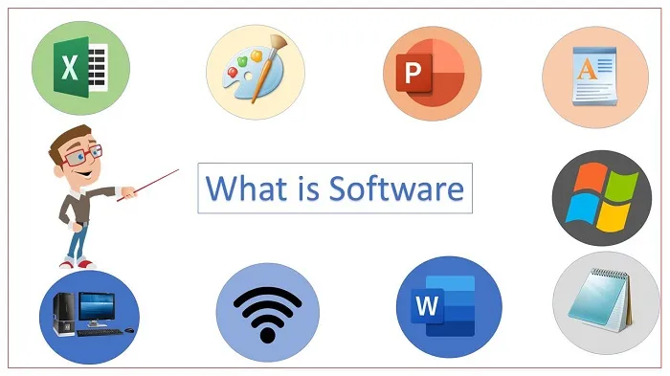
Software

Slide 14
Hardware
Computer hardware refers to a system's physical components, including the processor, memory, storage, input/output, and other peripherals. The purpose of computer hardware is to provide a platform for running software applications that allow users to perform various tasks efficiently.
Key: Touch and feel

Slide 15
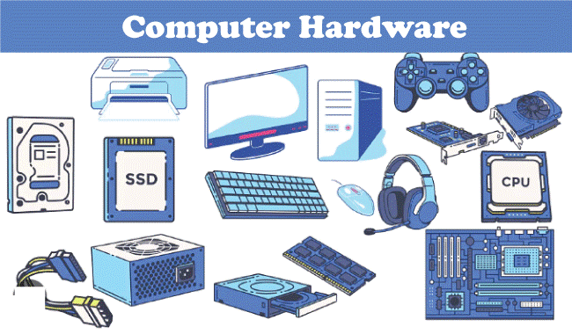
Hardware

Slide 16
Calculator explanation
Software/program ask system to allot memory for 3 variable a,b,c.
Software/program ask system to calculate some of a and b, and store in c.
Software/program ask system to display value of c

